Slide 1



LEGAL DATA ANALYSIS
MERGER CONTROL
Focus on the evolution of the number of French and European controls
Charles LOUIS-VICTOR and Quentin PINSOLLE

Slide 2






CONTENTS
Explanation of the process related to the Competition Authority
Explanation of issues related to the European Commission website
Analysis of scraped data

Slide 3

INITIAL AMBITION
Be aware of the number of controls carried out at the European level
M&A market analysis angle
Analyze at the French level
Analyze at the European level
Compare the data
Draw appropriate conclusions

Slide 4
PREREQUISITES
Retrieve the URL of the Authority's website
Install GoodSoup on Collab
Then retrieve each decision with:
date
name
type of decision
authorization/refusal
Store the data to create a data frame
Use the scraped data to create graphs

Slide 5
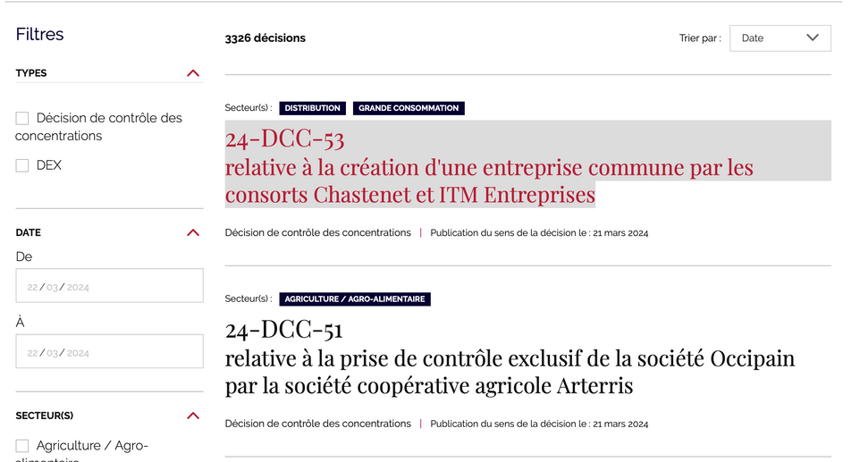
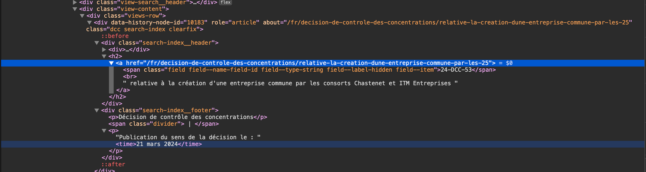
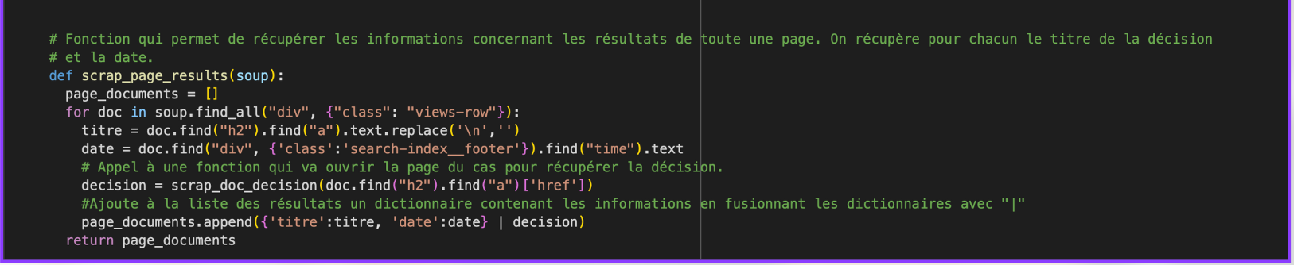
FRENCH AUTHORITY

Slide 6
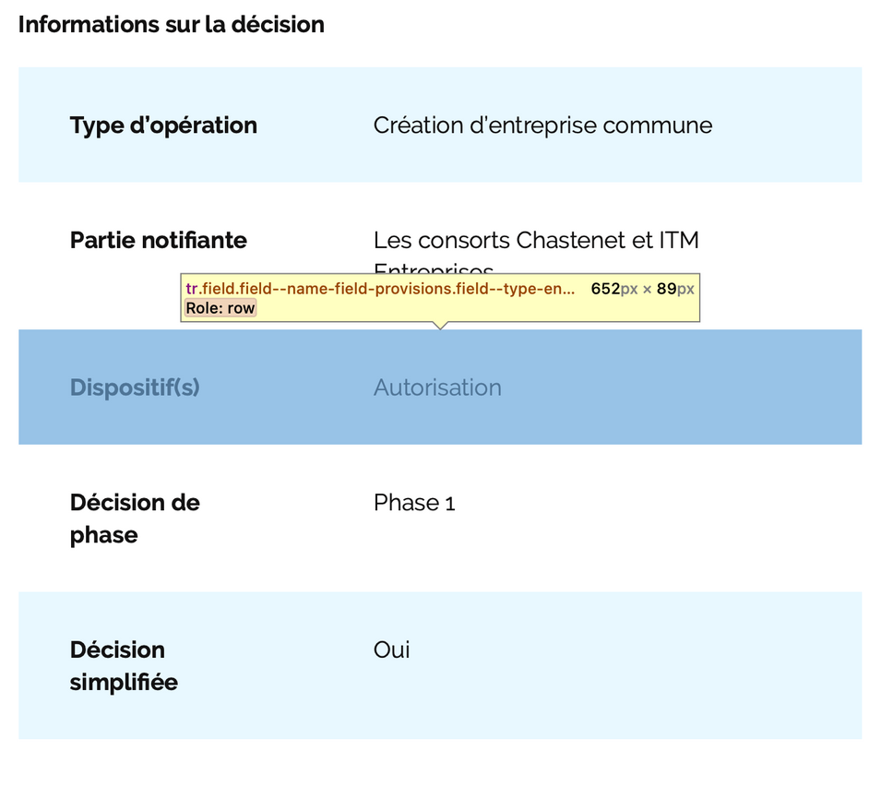
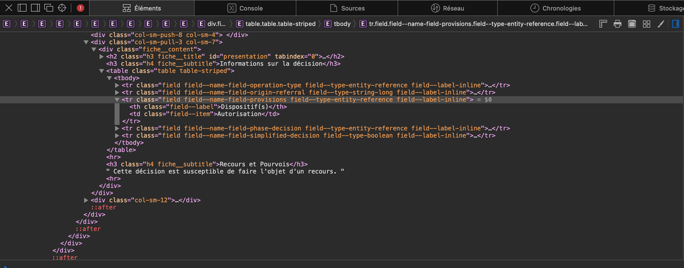

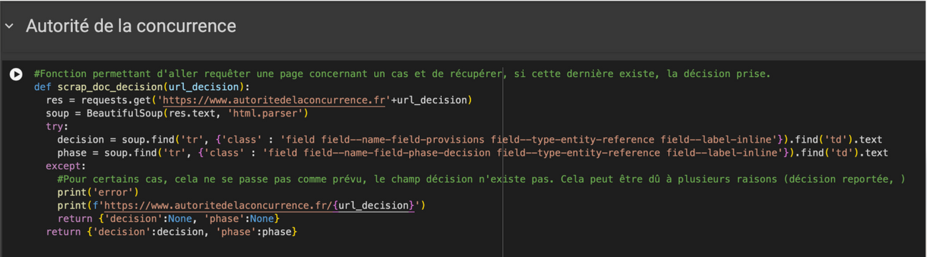
CODE ANALYSIS

Slide 7
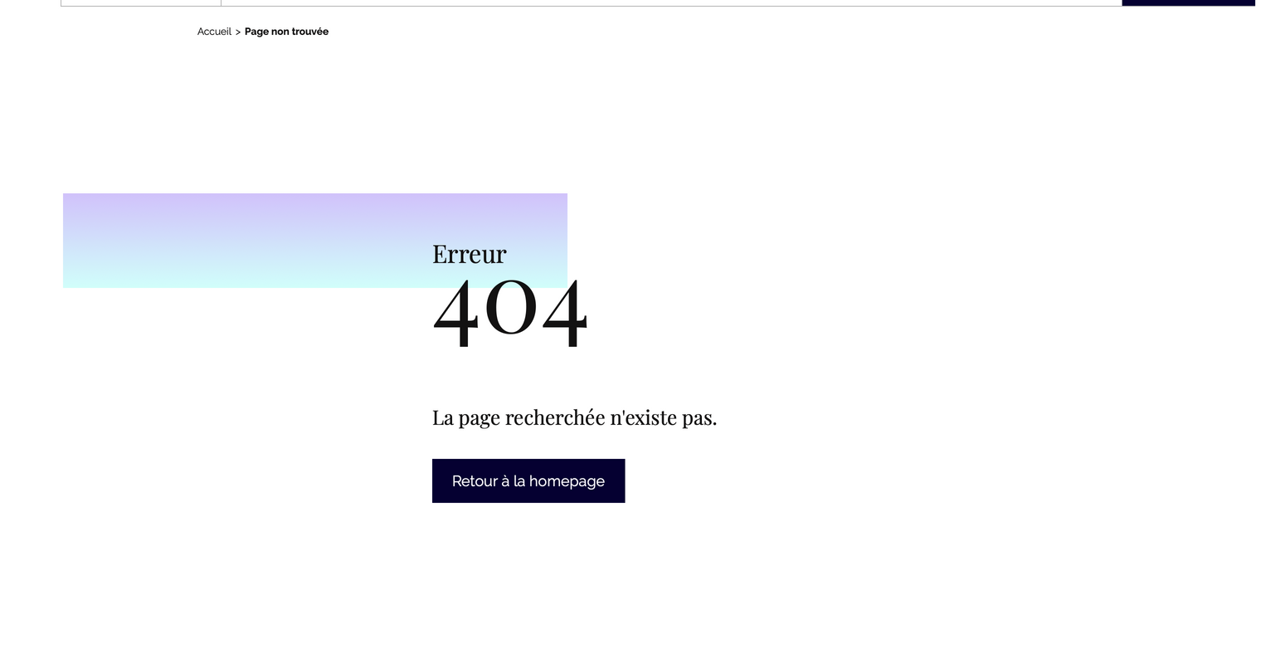
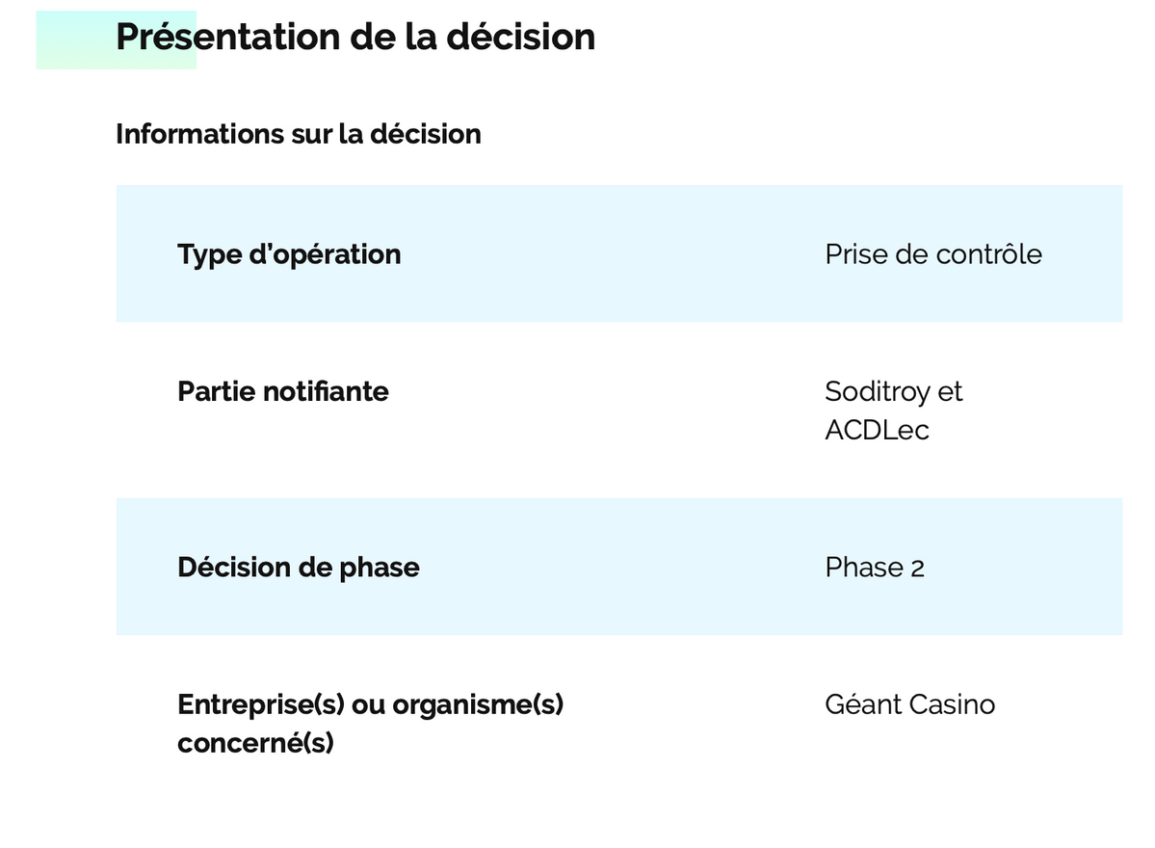
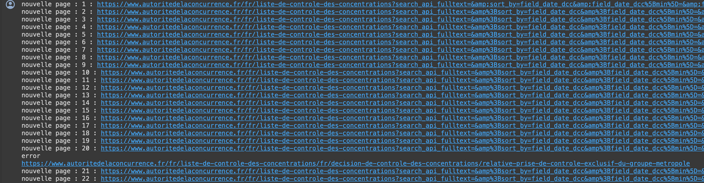


Slide 8
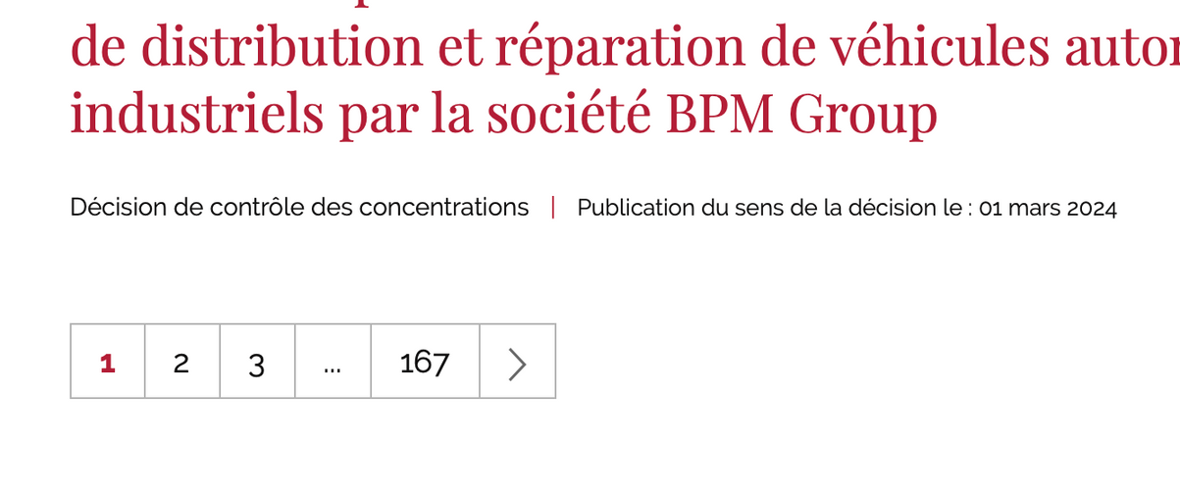
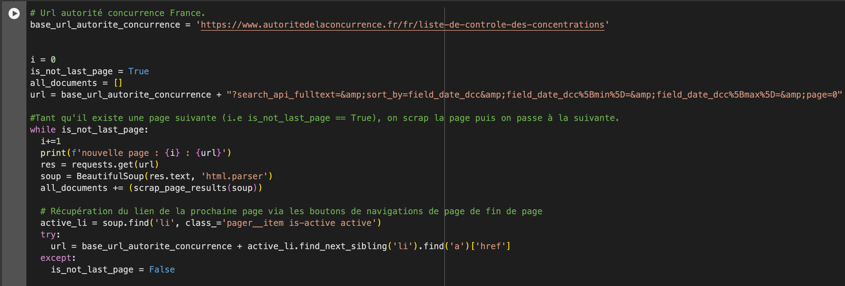
APPLY THIS TO ALL DECISIONS

Slide 9
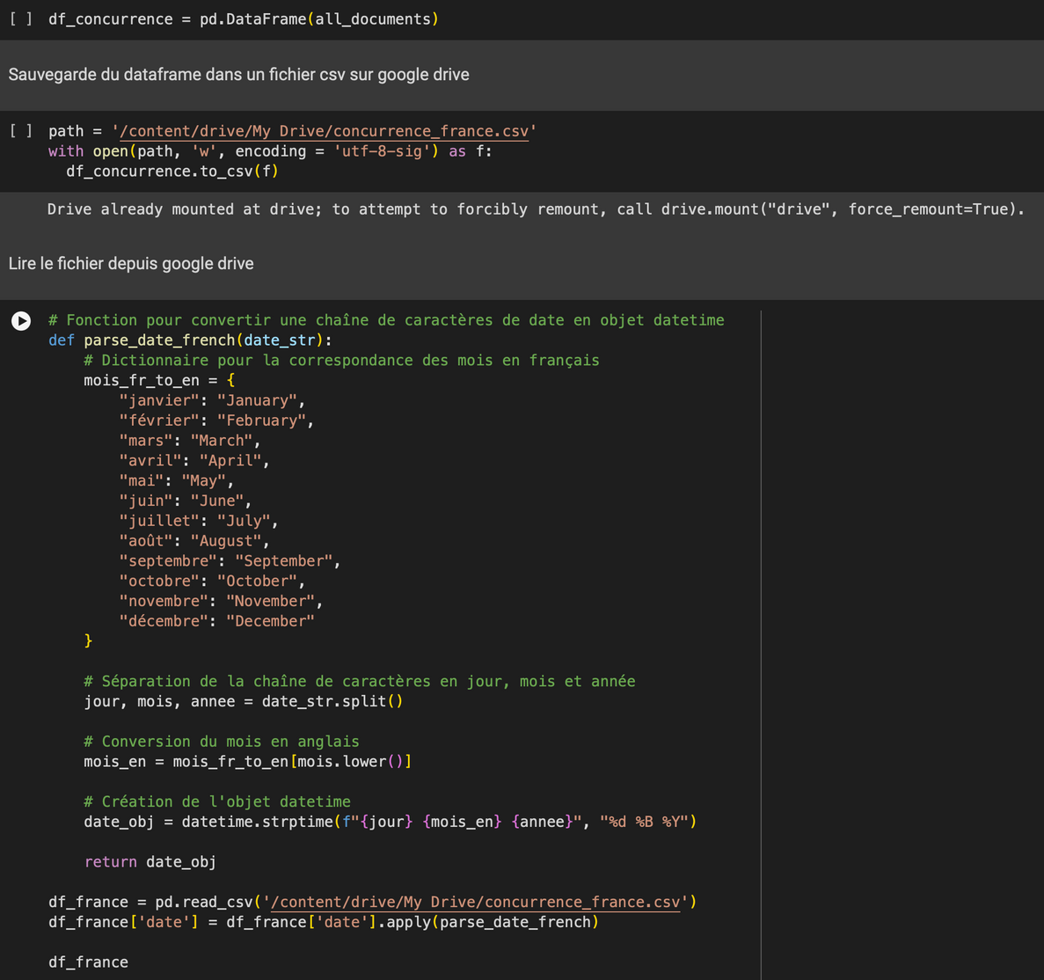
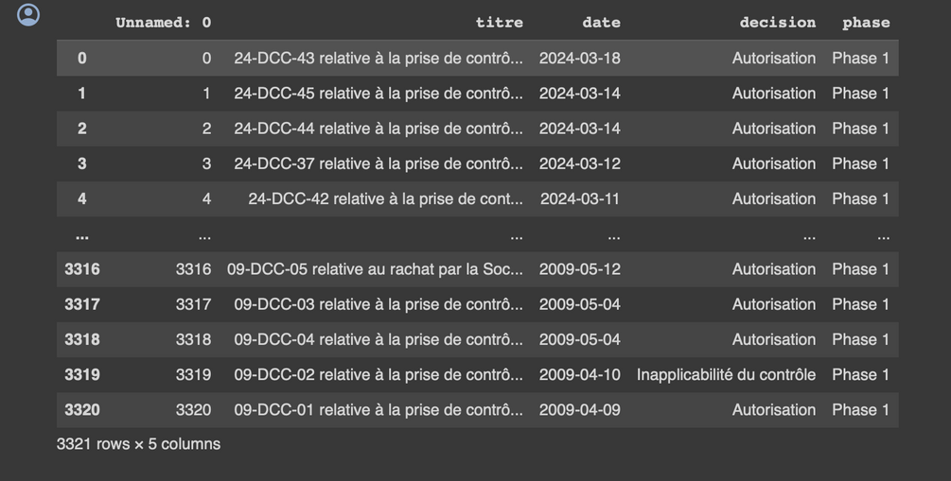
OBTENTION D’UN DATA FRAME, TRANSFORMABLE EN TABLEAU
Transformation du format de la date -> passer d’un format écrit à un format YYYY/MM/DD

Slide 10
GETTING A DATA FRAME, TRANSFORMABLE INTO A TABLE
Changing the date format -> switch from a written format to a YYYY/MM/DD format

Slide 11
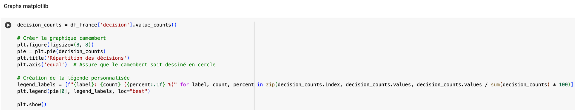
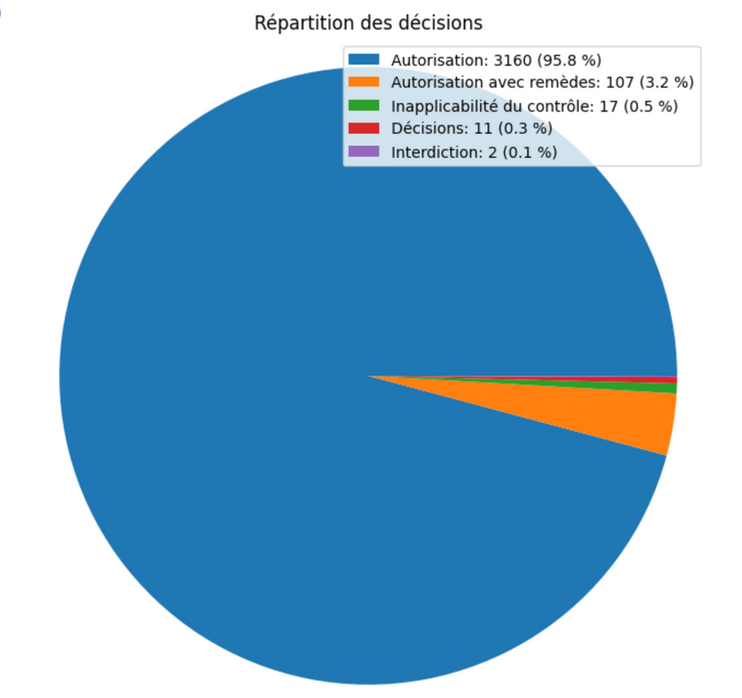
GRAPH CREATION THANKS TO CHATGPT

Slide 12
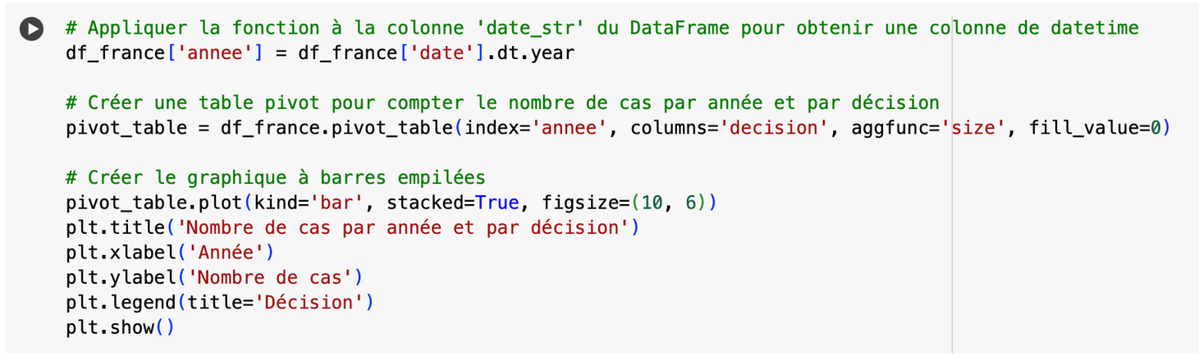
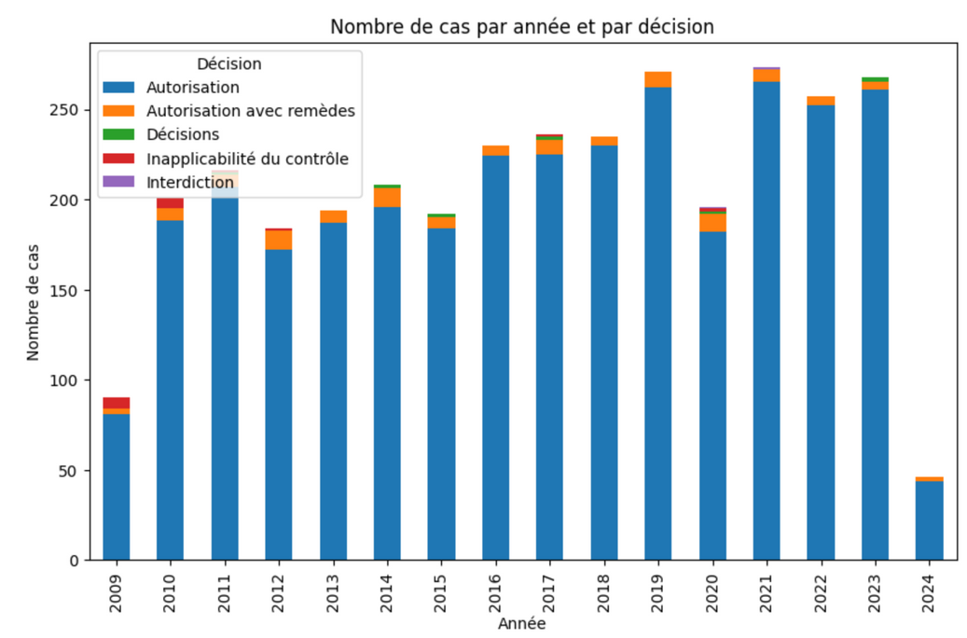

Slide 13
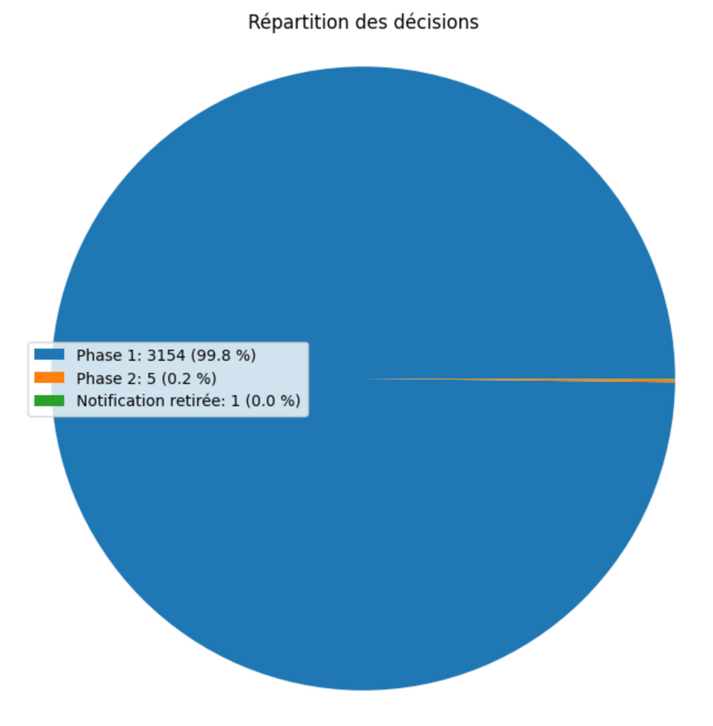
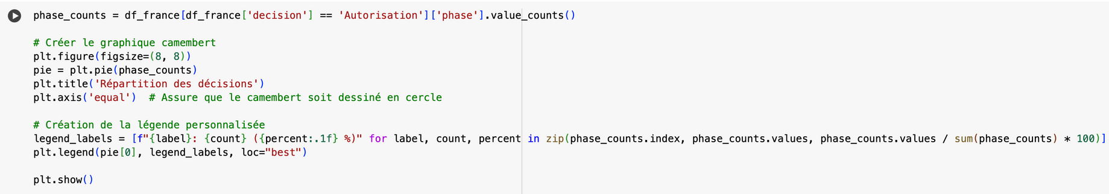

Slide 14
EUROPEAN COMMISSION
Different site and less intuitive
Intentional (?) blockage that makes scraping more complicated
Need to use Selenium to simulate a user
More data therefore complications related to the restricted display of decisions
Use the scraped data to create graphs

Slide 15
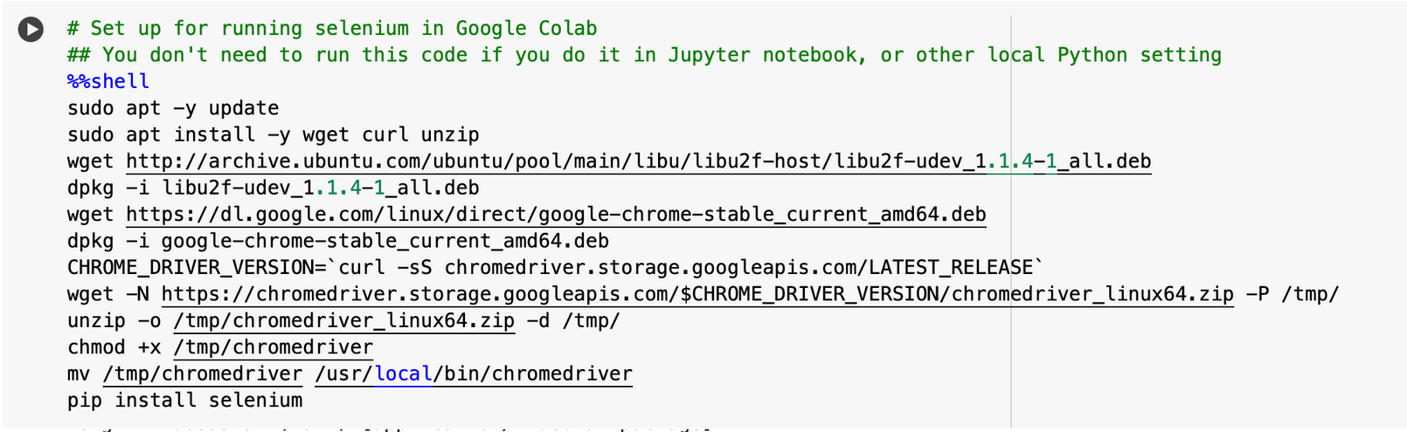
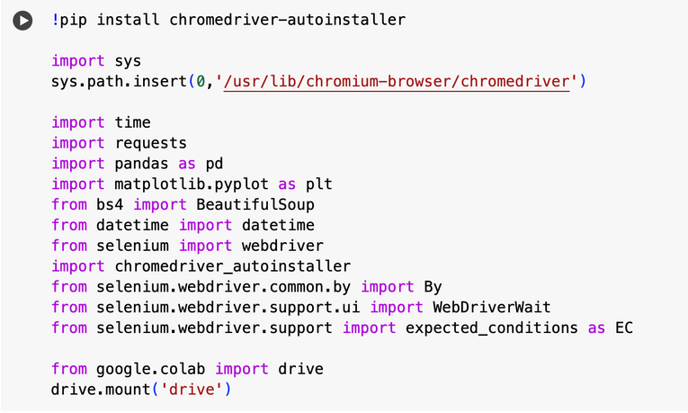
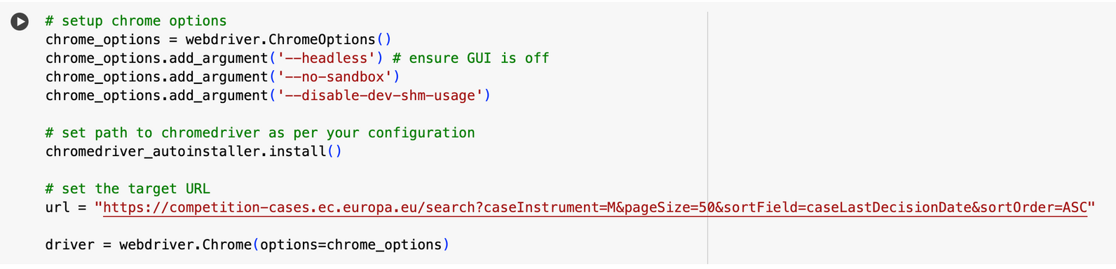
INSTALLATION DE SELENIUM ET CHROMEDRIVER

Slide 16
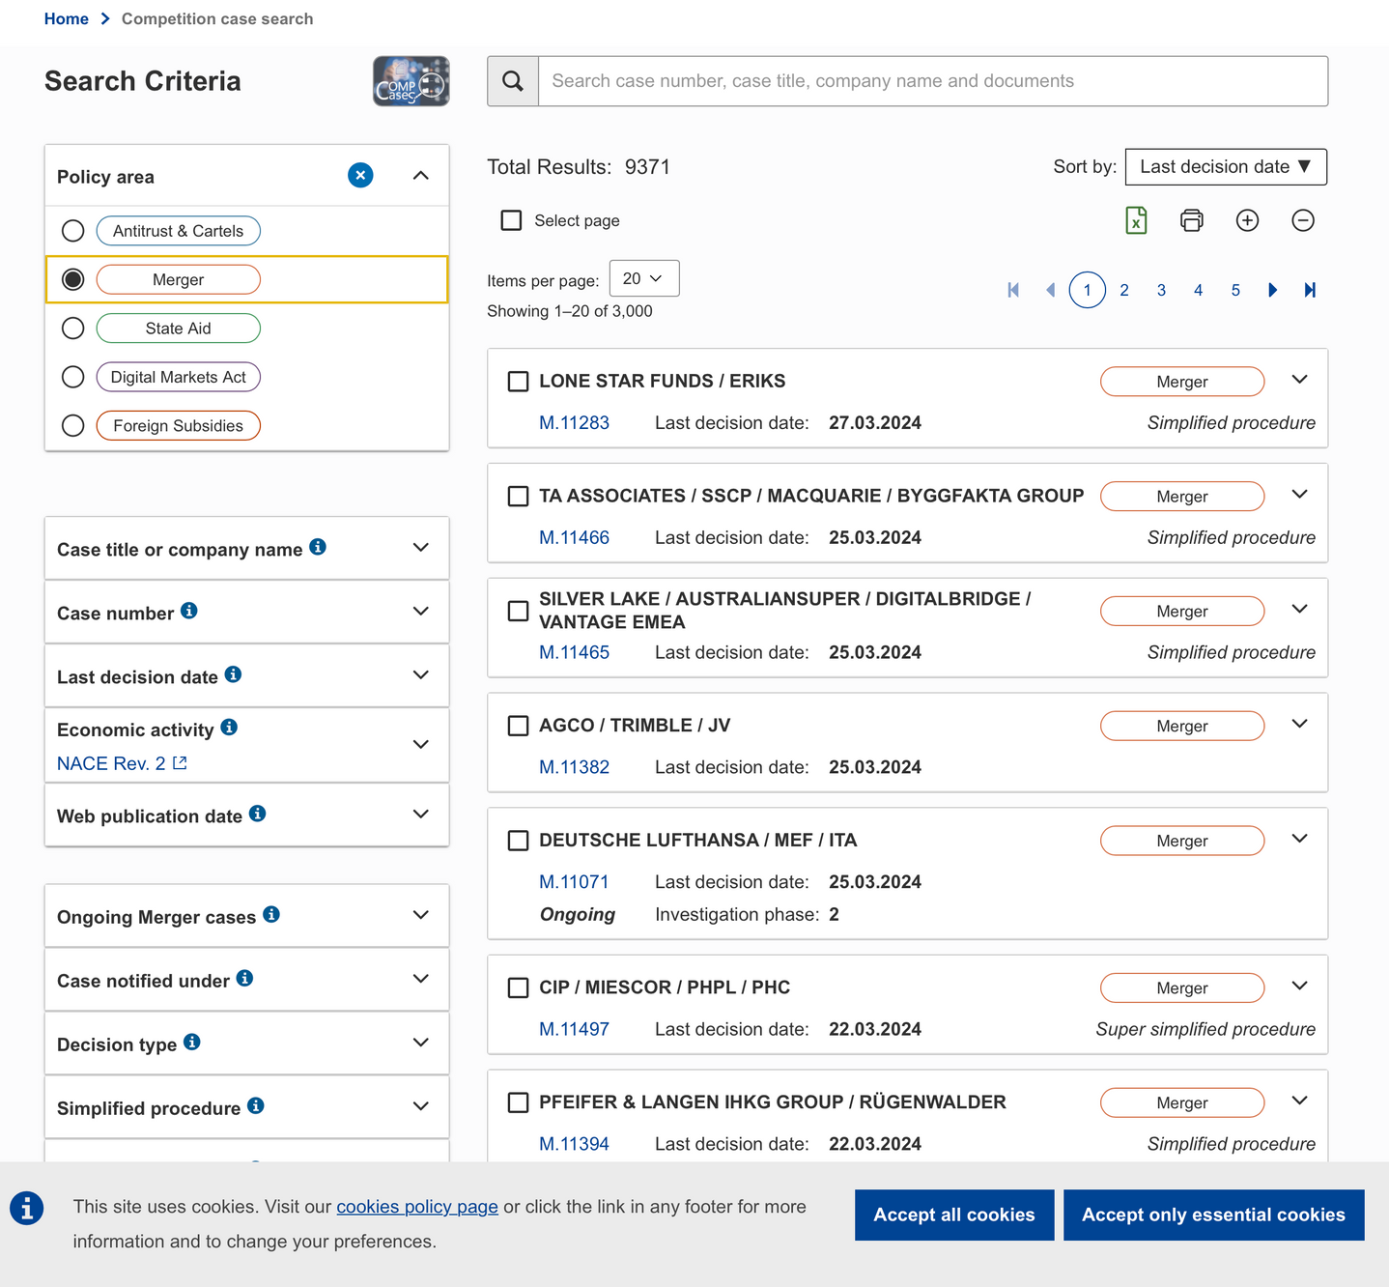

Slide 17
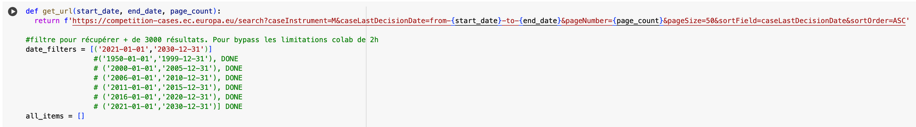
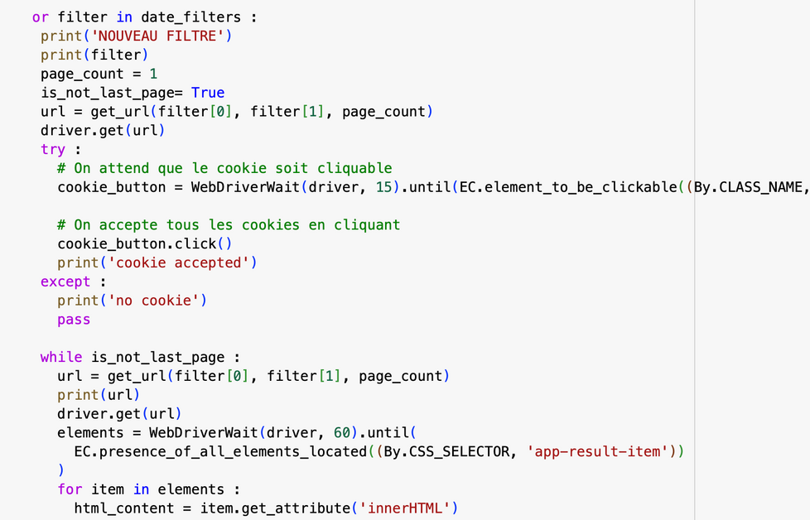
EXPLICATION DU CODE
1ère difficulté : le site n’affiche que les 3000 premiers résultats, sur + de 9000
-> donc on joue avec les filtres temporels
2è difficulté : le bouton des cookies qui bloque le scrapping
-> utilise selenium pour simuler un clic et accepter les cookies

Slide 18
CODE EXPLANATION
1st difficulty: the site only displays the first 3000 results, out of more than 9000
-> so we use time filters
2nd difficulty: the cookie button that blocks scraping
Use selenium to simulate a click and accept cookies

Slide 19
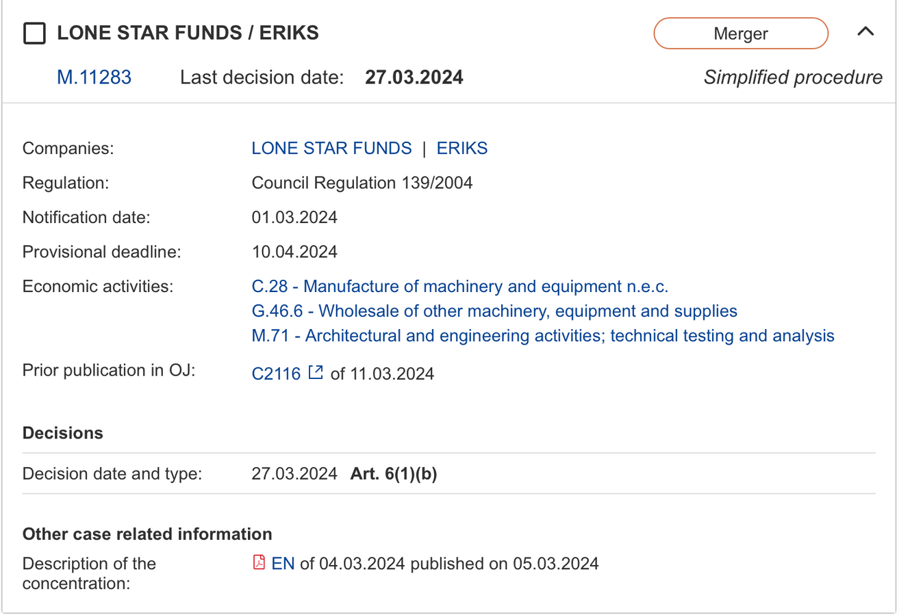

CODE EXPLANATION

Slide 20
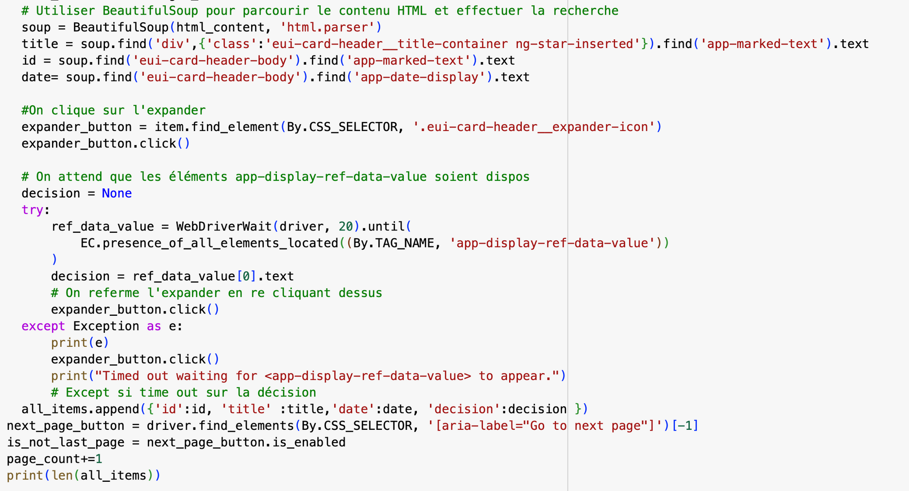
CODE EXPLANATION

Slide 21
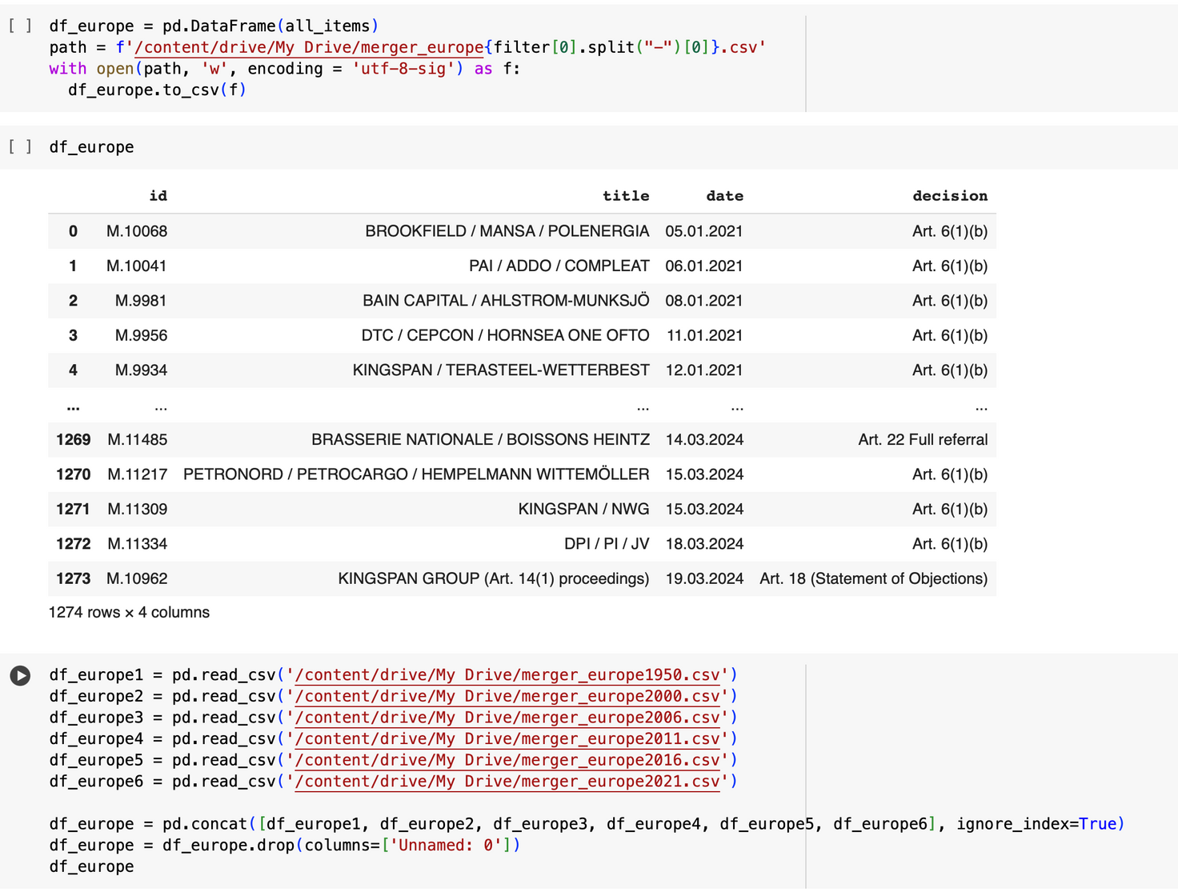
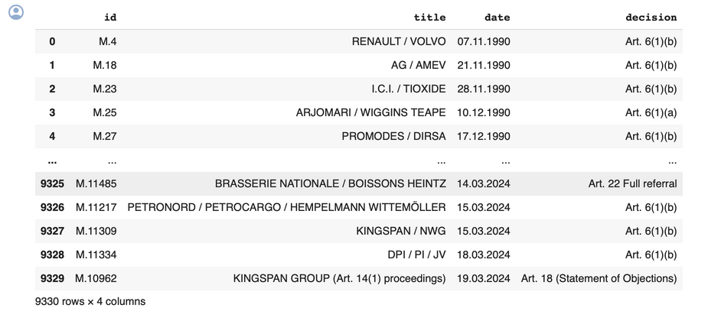
CODE EXPLANATION

Slide 22
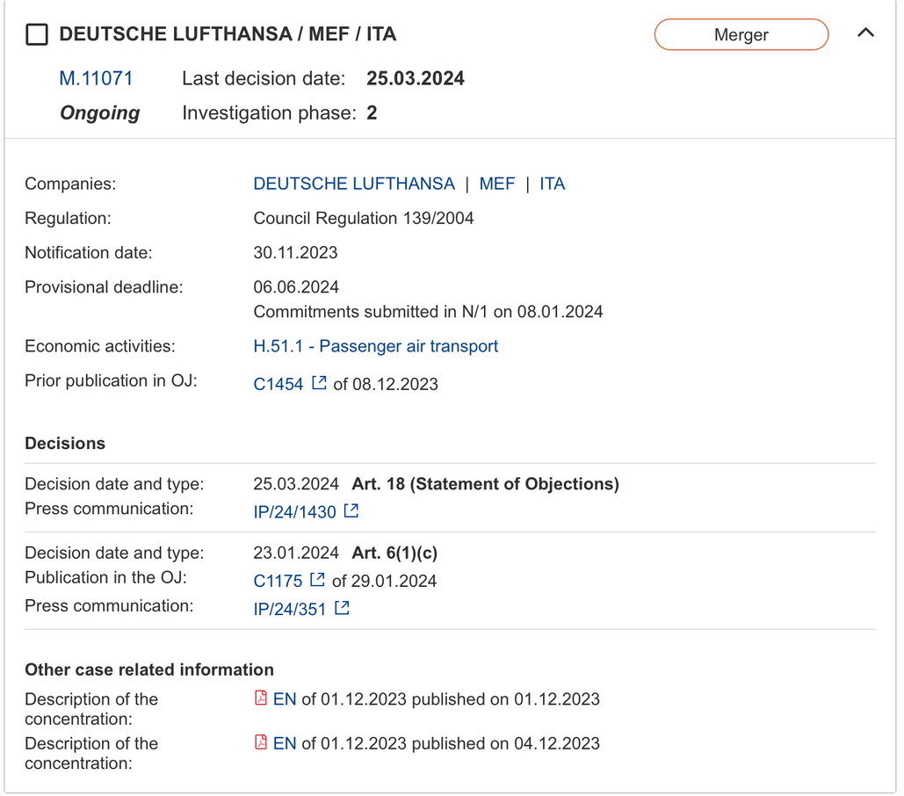
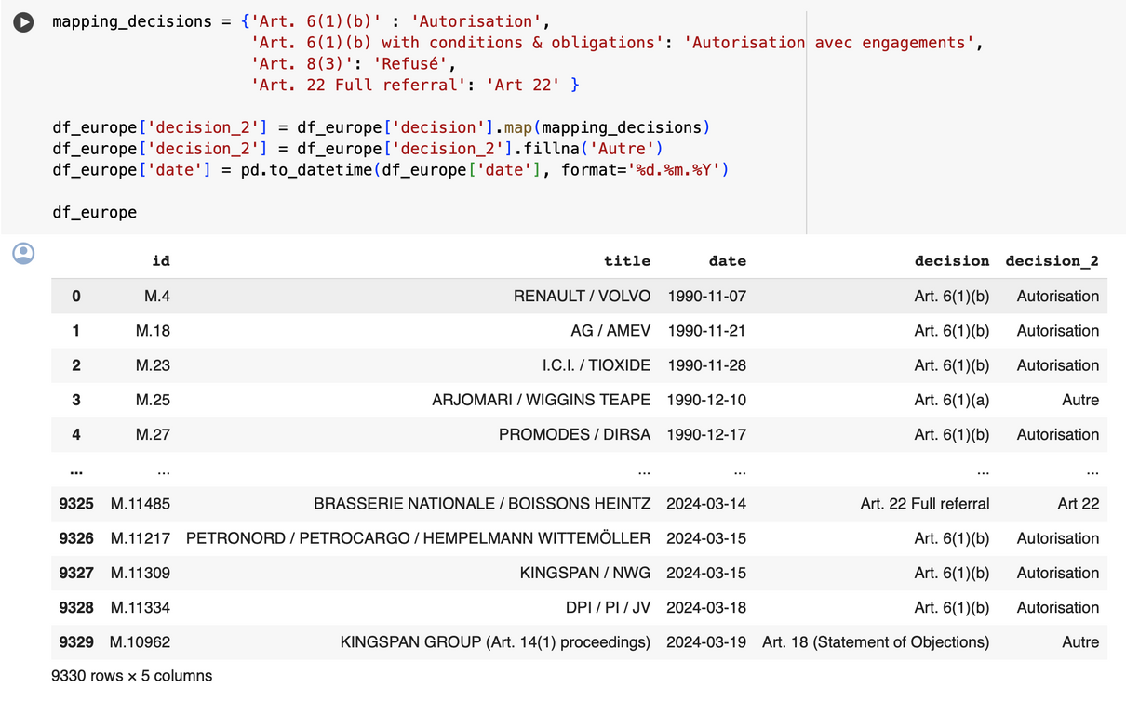
CODE EXPLANATION

Slide 23
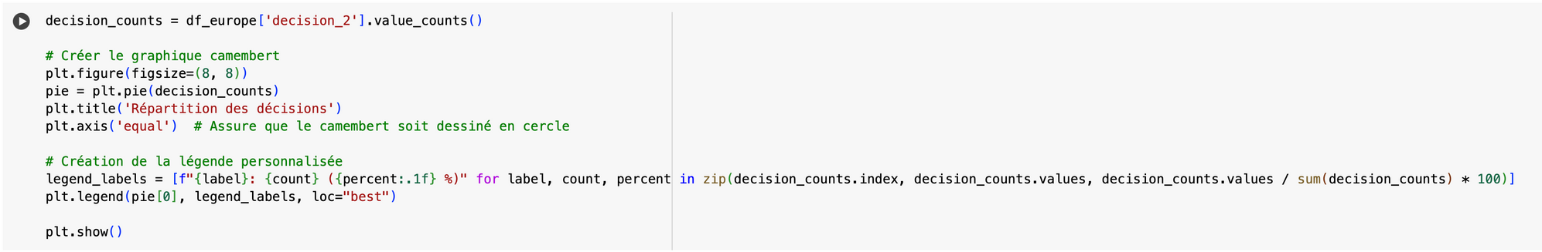
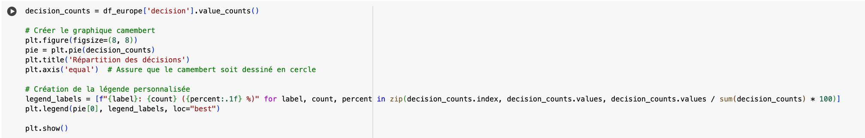
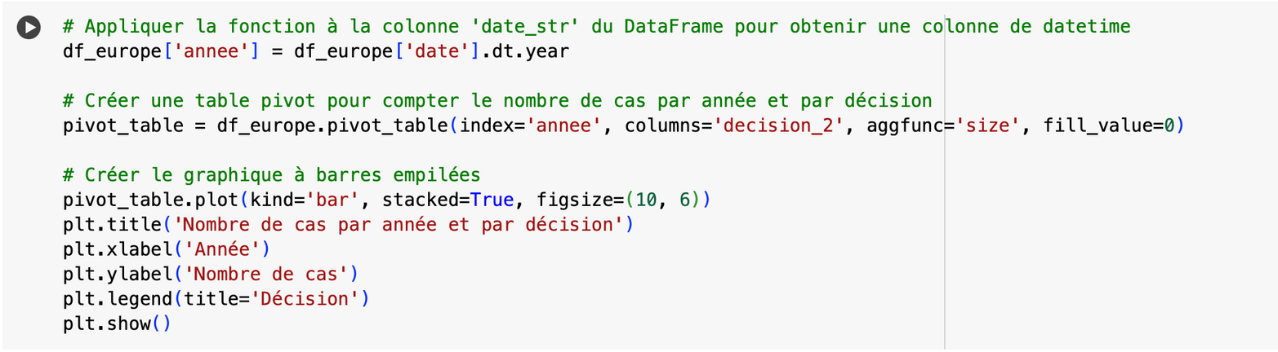
GRAPHIC CREATION

Slide 24

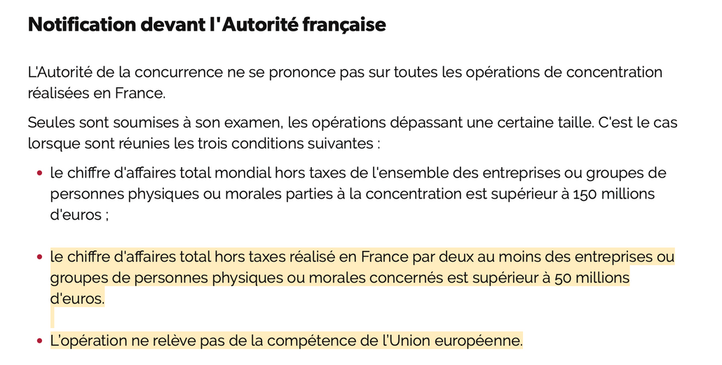
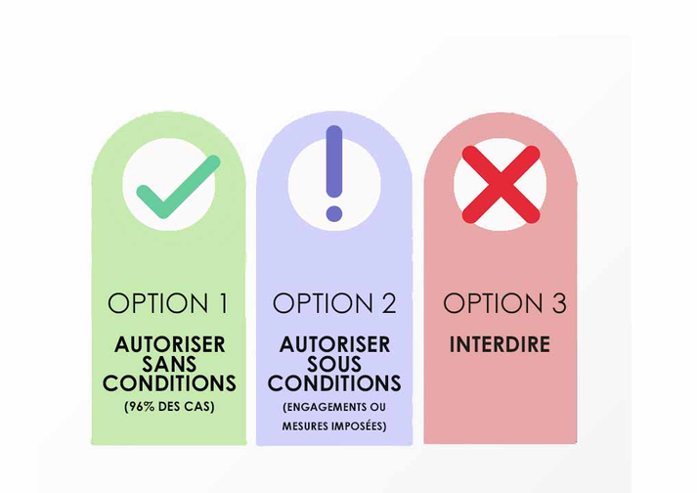
ANALYSE DES DONNÉES
TRÈS GRANDE MAJORITÉ D’AUTORISATIONS
LA PLUPART DES OPÉRATIONS NE POSENT PAS DE PROBLÈMES POUR LA CONCURRENCE

Slide 25
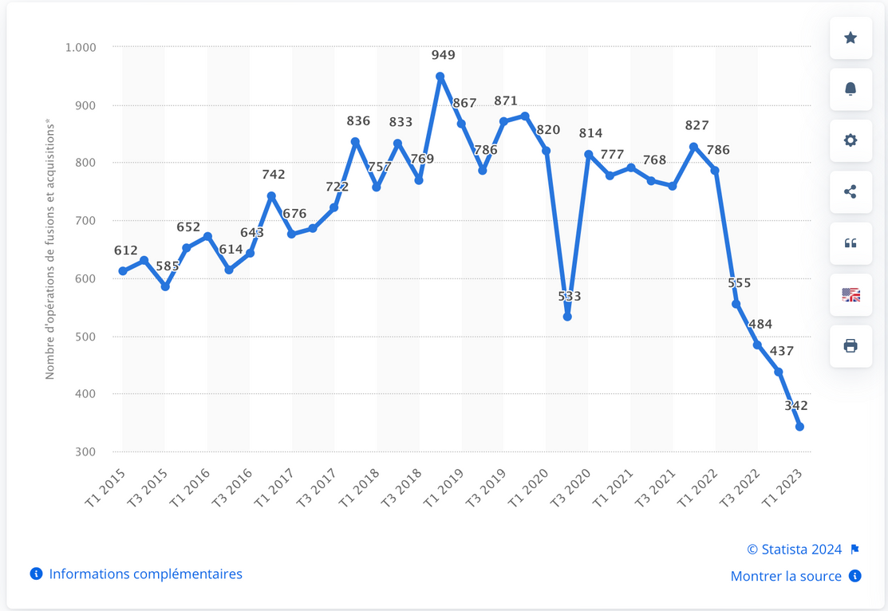
ANALYSE DES DONNÉES
Nombre d'opérations de fusions-acquisitions en France du 1er trimestre 2015 au 1er trimestre 2023

Slide 26
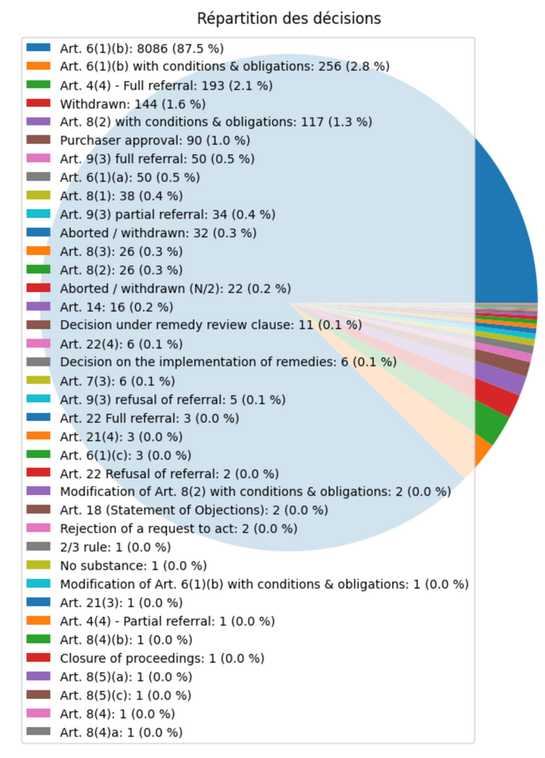
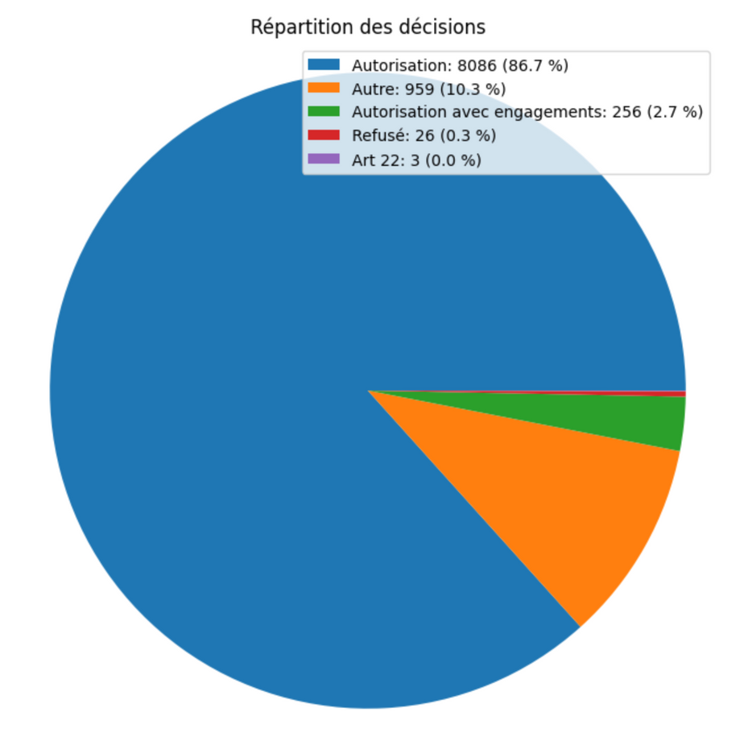
ANALYSE DES DONNÉES

Slide 27
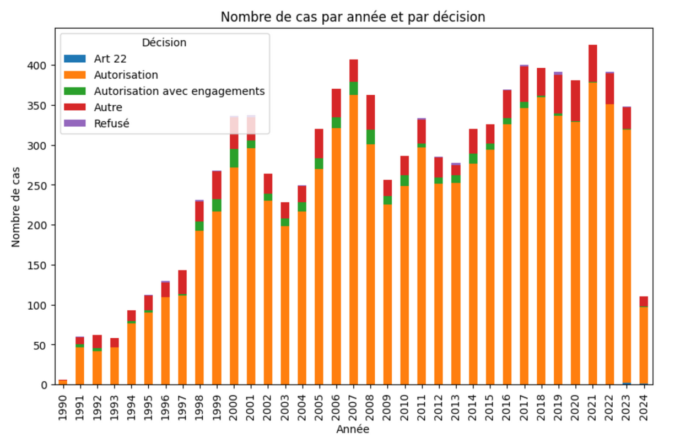
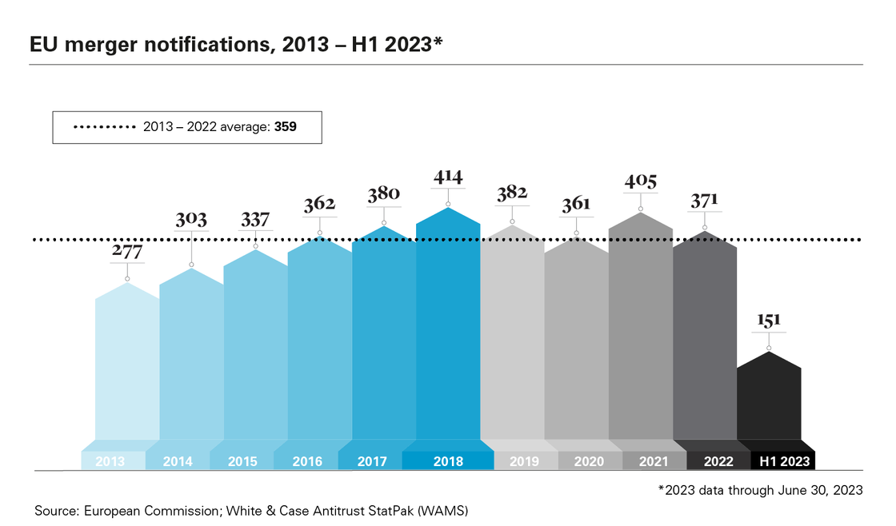
ANALYSE DES DONNÉES

Slide 28
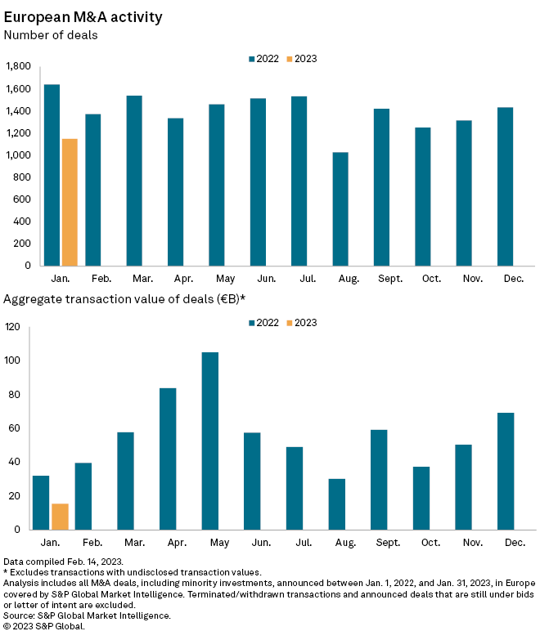
ANALYSE DES DONNÉES

Slide 29
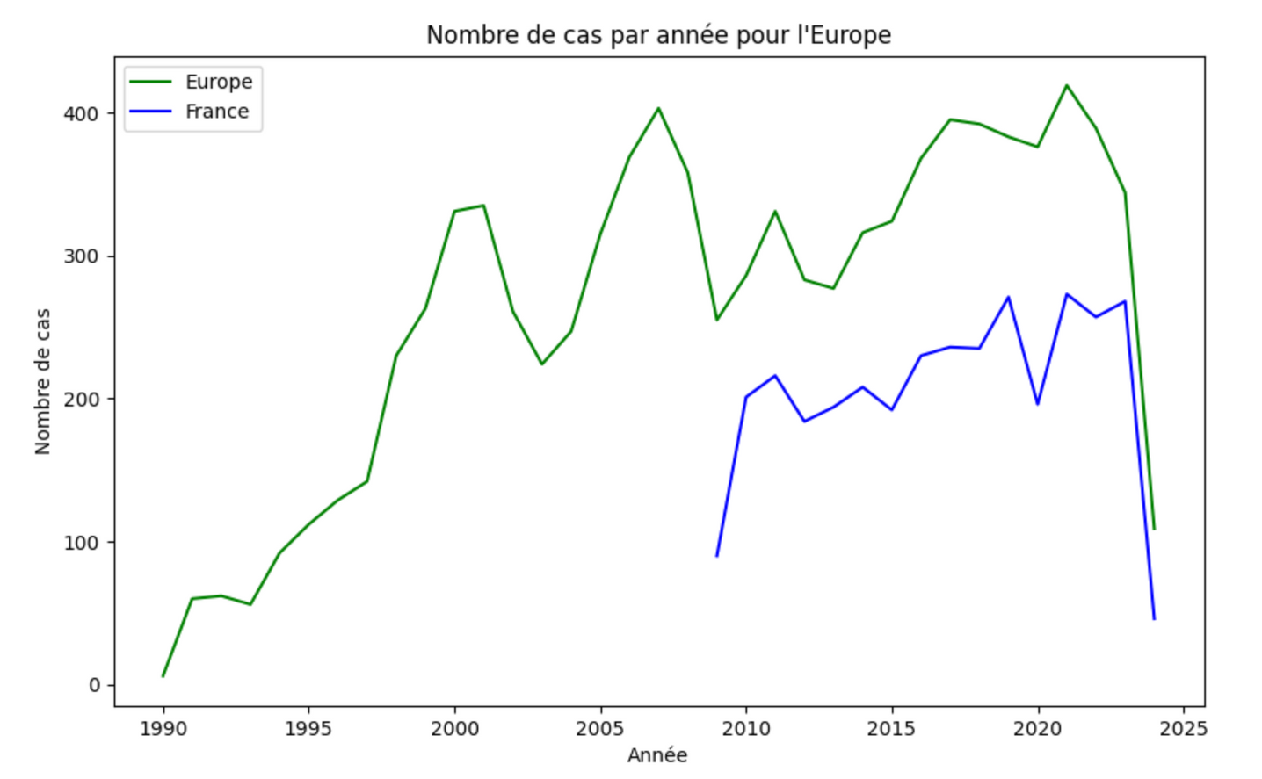
ANALYSE DES DONNÉES

Slide 30
LEGAL DATA ANALYSIS
THANK YOU
Charles LOUIS-VICTOR and Quentin PINSOLLE

